Slide 1
School Librarian Modeling Intellectual Freedom
ISLMA 2012
Barbara Fiehn, Western Kentucky University
Rebecca P. Butler, Northern Illinois University
© 2012 Fiehn and Butler

Slide 2
Intellectual Freedom Scenarios and Responses/Modeling Activities
Copyright
Access to Information
Privacy

Slide 3
Copyright Scenario #1: Scanning Workbooks
The school librarian observes a teacher scanning a workbook onto her computer. She informs the librarian that it is too expensive to keep buying it for the class, so she will keep a copy on her computer and print it out for each student, as needed.

Slide 4
The librarian realizes that the workbook is a consumable product, and that the publishing house for the workbook plans on selling a copy for each student per year. It does not give the rights to educators to copy the workbook and print it out for classes.

Slide 5
Copyright Scenario #1: Modeling Activities
Possible non-threatening responses that the librarian might give to the teacher:
Tell the teacher that you are uncomfortable she is scanning the workbook, since such a use is probably a copyright infringement.
Offer to help the teacher find and write a grant, which will purchase the workbooks for her class.

Slide 6
Ask the teacher if she could place needed workbook pages on an ELMO or other projection device so that students might view the page from the large screen.
Offer to help the teacher look for a similar/cheaper/free workbook for purchase.

Slide 7
Volunteer to ask the PTO if they might be able to purchase the needed workbook for all class students.
Check into the availability of mobile hand-held devices that might hold copies of the workbook. (Again, look for funding – as given above – for these devices and the electronic version of the workbook.)

Slide 8
Intellectual Freedom
Materials Selection
Policies and practices of providing materials
Needs of ALL students
Curriculum needs
Extracurricular student needs
Selection aids
Perceived values schema varies / you serve a wide range of students
Notes:
Intellectual Freedom resides within all our Policies and Procedures. Write for the newsletter about selection process and serving the needs of all students. Educate Staff

Slide 9
Intellectual Freedom
Library Management & Programs
Deselection
MARC Records – ranges vs specific grade levels
Circulation restriction/interlibrary loan
Reserved materials
Confidentiality / Privacy
Censorship
Notes:
Eliminate stereotyped materials, make MARC records user friendly giving grade and age rangers rather than specific grades, use as wide a lexile range as possible. Review procedures to allow for increased access. Who said primary students can take out only one book? Who decided students can come to check out materials only once a week. Who decided only teachers can use interlibrary loan? Do reserved materials help or hurt student access, can they be taken home over weekends/overnight? Do you preserve student privacy and do your students know it? Is your stand on Censorship visable? Use ads, displays, display first, fourth, and fifth amendments and Universal Declaration of Human Rights

Slide 10
Access to Materials #1
Resist Abridgement of Reader Rights
Restriction of access
Teacher is overhead telling a student to return a book just checked out because it is not in his reading level. As a media specialist, how do you react?

Slide 11
Access to Materials
Separate reading instruction from personal reading
Refuse to add and remove existing book spine labels indicating reading levels

Slide 12
Post in your Library
Reader friendly rules
Rights of the Reader by Daniel Pennac
http://www.walker.co.uk/UserFiles/file/Rights%20of%20the%20reader/NYOR_ROTR.pdf

Slide 13
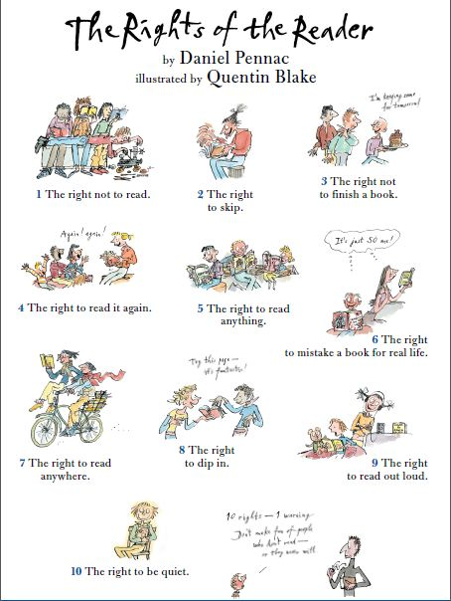

Slide 14
Labeling and Privacy
Reading Level labels
Research Activities
Confidentiality of information from parents
Library Records
Overdue Notices
Notes:
Understand student rights, your rights, and help students, faculty and parents understand

Slide 15
Privacy Scenario
Overdue notices
Fold and tape or staple with only name showing.
Posted lists include only name
Do not read names during check out time

Slide 16
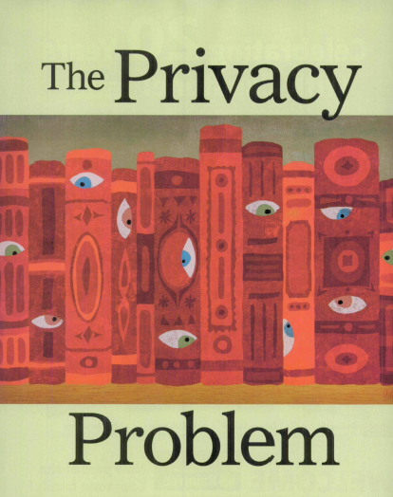

Slide 17
Privacy Scenario
The parents of a high school senior (he is 18) come to you and asks for their child’s check-out record. You feel that this may be a violation of the student’s privacy, but are unsure as to how to handle this. On the next slides are some actions that could have been taken earlier to prevent such records being available or which you might be able to take now.

Slide 18
Privacy Scenario Responses/Modeling Activities
Use an automated circulation system which deletes the user record once the item is returned.
Use or set your automation system so that does not keep the history of who checks out which item.

Slide 19
Gently inform the parents that FERPA states educational records (library records possibly may be interpreted to be educational records – this is a gray area of the law) belong to the student at age 18. Therefore, you would feel more comfortable asking the student is he is willing to let his parents see his circulation records.

Slide 20
If confidentiality of school library records is part of your state law, inform the parents of this.
If confidentiality of school library records is part of your library’s or school’s policy, inform the parents of this.
Make sure that overdue notices are confidential (i.e., not placed on a library bulletin board or web page, etc.)

Slide 21
Make sure that all library records, including circulation records, are inaccessible to the public and/or destroyed in a timely manner.
Notes:
This includes sign-up sheets of any kind, holds and reserves, Post your state privacy law,

Slide 22
Copyright Scenario #2: Video on the Internet
A class instructor finds a video on the Web that he would like to use with his sociology class. He asks if you can help him show it in his classroom via a computer and projector.

Slide 23
You surmise that he is asking for a “video-on-demand.” While you realize that it may be possible to accommodate his request, you also realize that licenses or permissions may be involved. Thus, you respond to him as follows:

Slide 24
Copyright Scenario #2: Responses/Modeling Activities
Questions to ask the sociology teacher and responses based on those questions:
Does the Internet site you obtained the movie from have a license that you must agree to before using the film?
If the answer is yes, then follow the licensing information and show the film in the classroom. (Butler, 2011, 102)

Slide 25
Does the movie Internet site have a specific copyright policy that you must follow in order to use the film?
If the answer is yes, then follow the copyright policy information and show the film in the classroom. (Butler, 2011, 102)

Slide 26
Does the use of this film fit under fair use or another statutory exemption?
If the answer is yes, then show the film in the classroom.
Is this film in the public domain?
If the answer is yes, then show the film in the classroom. (Butler, 2011, 102)

Slide 27
Do you have permission from the film’s owner to use the film, as obtained through video on demand, in the classroom?
If the answer is yes, then show the film in the classroom. (Butler, 2011, 102)

Slide 28
Do you have permission from the website creator (or administrator) to use the film, as obtained through video on demand, in the classroom?
If the answer is yes, then show the film in the classroom.
If the answer is no to all of these questions, then find another film for the sociology instructor to use with his class. (Butler, 2011, 102)

Slide 29
Notes:
Educate students about Internet use. Social Media Use,

Slide 30
Intellectual Freedom
The right of every individual to seek and receive information from all points of view without restriction.
Adams p. 11
Include ALL students in Media Center activities

Slide 31
Disabled Students
Insist on physical ease of access, ramps, lifts, low sight readers
Co-plan with special educators for student access
Ensure appropriate collections
It’s the Law: ADA, Rehabilitation Act, Individuals with Disabilities Education Act.

Slide 32
Access to Programs
Plan all library programs for inclusion.
Awards for reading are obtainable for all students.
Guest speakers are prepared for all students
Promotions include all students

Slide 34
Internet Access
Access policy – clear guidelines about what is acceptable and what is not. Filters do not always work
Student Rights of Access – who adjudicates requests for unblocking
Student responsibility
Teacher rights to access – Understand your state laws as well as CIPA – Stand up for your rights and those of your students.
Notes:
Be Responsible sign, post information about how to get a site unblocked, Celebrate Banned Website awareness day – Over filtering of the Internet may be the district’s right, but don’t let them pass it off as “required by the law”
Over filtering is a form of Censorship

Slide 36
Access to Information
Restricted Shelf – parental permission needed Attaches a stigma
Restriction by reading/grade/ability level
Behavior restricts access
These are all forms of censorship. Courts have said – only parents can restrict access
Notes:
Post your state privacy law, take a stand against labeling and restricting

Slide 37
References
Adams, H. R. (2008). Ensuring intellectual freedom and access to information in the school library media program. Westport, CT: Libraries Unlimited.
Butler, R.P. P. 2004. Copyright for Teachers and Librarians. New York: Neal-Schuman.
Butler, R. P. 2011. Copyright for Teachers and Librarians in the 21st Century. New York: Neal-Schuman.
Butler, R. P. 2009. Smart Copyright Compliance. New York: Neal-Schuman.
Office for Intellectual Freedom. 2010. Intellectual Freedom Manual, 8th ed. Chicago: ALA.

